Slide 1

SCHOOL ENROLLMENT & EDUCATION PERFORMANCE ANALYTICS PLATFORM
Ensuring data-driven analytics and actionable insights
By
Bhavitha Sai Priya
Jan 2026

Slide 2


ABSTRACT
This project presents an end-to-end School Enrollment and Education Performance Analytics Platform built using modern data engineering and analytics technologies. The system leverages Databricks, Apache Airflow, and Power BI to automate the ingestion, transformation, and analysis of large-scale educational datasets. By adopting a Medallion Architecture, the platform enables clean data processing, scalable analytics, and actionable insights. The solution supports performance monitoring, enrollment trend analysis, and target-versus-actual evaluation, helping educational institutions transition from traditional reporting to data-driven decision-making.
2

Slide 3

PROBLEM STATEMENT
Educational institutions generate large volumes of enrollment and performance data Data is spread across multiple sources and formats Traditional processing methods are manual and inefficient Lack of automation limits timely insights and trend analysis Difficulty in evaluating performance and measuring progress against targets Need for a scalable, automated, analytics-driven platform
3

Slide 4


OBJECTIVES
To design and implement an end-to-end ETL pipeline for education enrollment data
To clean, standardize, and validate raw datasets using scalable data processing techniques
To generate analytics-ready datasets for performance evaluation and reporting
To automate data workflows using Apache Airflow
To support data-driven decision-making through structured analytics outputs
4

Slide 5
DATASET
DESCRIPTION
  School-level enrollment and academic performance data
  Collected across multiple academic years
  Includes records from different schools, grades, and districts
  Contains demographic details such as gender-wise enrollment
  Includes attendance rates, pass rates, and performance indicators
5

Slide 6

DATASET
SCHEMA
  School identification and location details
  Enrollment, grade, and gender information
  Academic performance metrics (scores, pass/fail rates)
  Attendance and exam participation indicators
  Remedial, digital access, and scholarship metrics
  Learning growth and skill index measures
6

Slide 7

METHODOLOGY
The project follows a Bronze–Silver–Gold data architecture. Raw data is ingested into the Bronze layer, cleaned and standardized in the Silver layer, and aggregated into analytics-ready Gold tables. PySpark is used for scalable data processing, while Delta Lake ensures reliability and performance. Workflow orchestration is handled using Apache Airflow, enabling scheduled and automated execution. The final analytics outputs are visualized using Power BI.
ETL WORKFLOW
Extract
  Read multiple raw CSV enrollment files
  Store as Bronze Delta tables
Transform
  Data cleaning and validation
  Feature engineering
  Performance metrics calculation
Load
  Store cleaned data in Silver layer
  Analytics tables in Gold layer
7

Slide 8
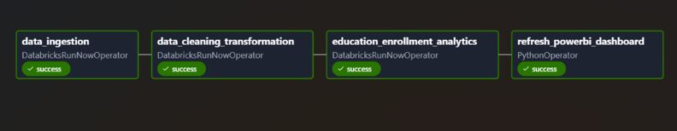
WORKFLOW ORCHESTRATION
Apache Airflow used for pipeline automation
Weekly scheduled execution
Sequential tasks:
  Data Ingestion
  Data Cleaning & Transformation
  Analytics & Gold Table Creation
  Power BI Refresh
8

Slide 9
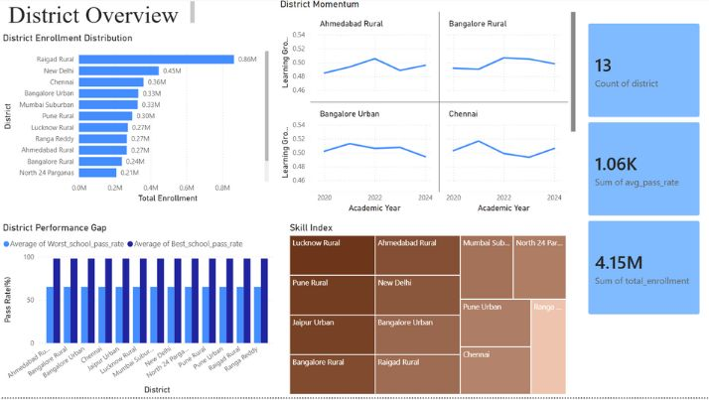
  YEAR-WISE ENROLLMENT TRENDS
  GENDER-WISE AND GRADE-WISE ENROLLMENT DISTRIBUTION
  DISTRICT AND SCHOOL-LEVEL PERFORMANCE COMPARISON
  ATTENDANCE VS ACADEMIC PERFORMANCE ANALYSIS
  LEARNING GROWTH AND SKILL INDEX EVALUATION
  ENROLLMENT ANALYSIS
  DROPOUT ANALYSIS
ANALYTICS
DATA PROCESSING INTO SCALABLE, DATA-DRIVEN SYSTEMS FOR INFORMED DECISION-MAKING.
9

Slide 10
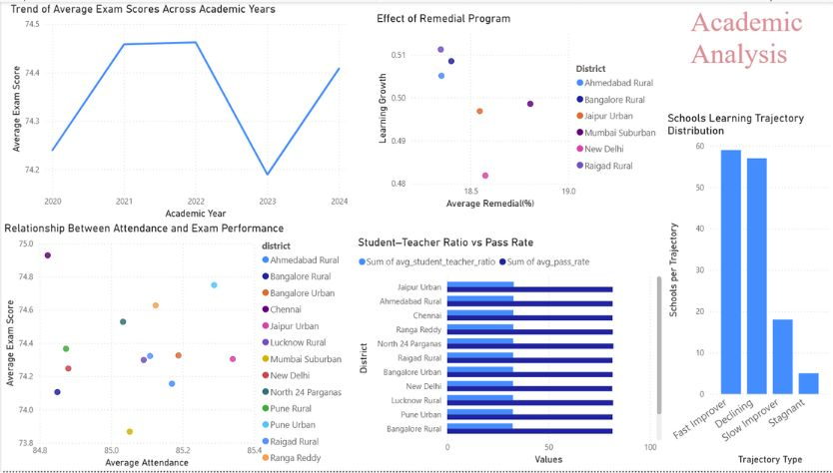

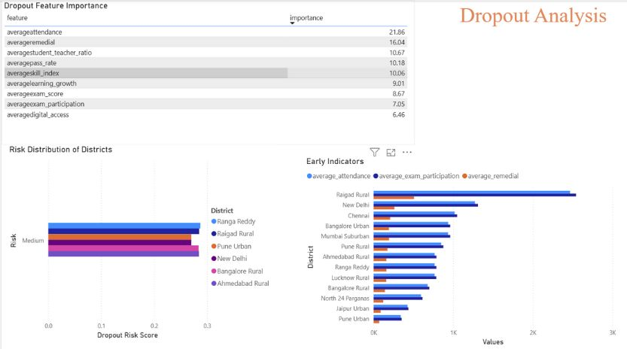
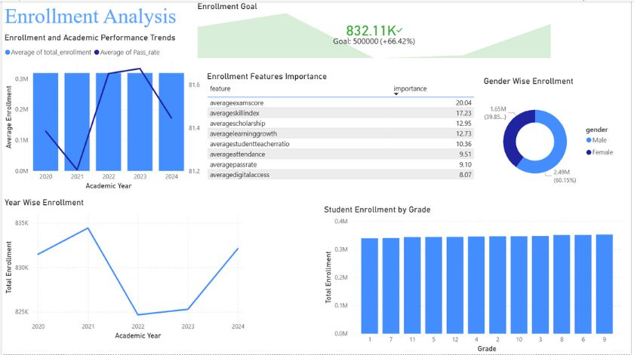
Highlighting how modern data pipelines and analytics technologies are transforming traditional education reporting into automated, insight-driven decision systems
10

Slide 11

CONCLUSION
The project successfully demonstrates how modern data engineering and analytics technologies can transform traditional education data processing into an automated, scalable, and insight-driven platform. By integrating cloud-based processing, workflow orchestration, and interactive visualization, the solution provides meaningful insights that support informed decision-making in the education domain
11

Slide 12
THANK YOU
12

